Slide 1
Litter Recognition 1 - Bi-weekly Progress 31st January
Presented by Jude, Ryan, Jack, Hanzhong, and Sriram.

Slide 2
Top-Down Project Structure
From a top-down view, the goal of our project has been to create an autonomous system, using an arduino robot arm, that can pick up and identify different types of litter. This slide showcases the remaining ‘Epics’ of our project and our definition of done for each.
Remaining Epic | Definition of Done
Implement Inference Code | Real time object detection running on the pi cameras using our model.
Camera feed sent back to Raspberry Pi | Multi camera module working and sending back two camera feeds to the Pi.
Distance Calculation | Distance between the arm and litter correctly calculated.
Code to pick up litter | Arm picking up detected litter from an unspecified orientation.

Slide 3
Ryan - Client Liaison
Wrote inference code for real time detection with our model.
Created the participant information sheet for testing day.
Created the consent form for testing day.
Made an attempt to create a Continuous Deployment action for our GitHub.
Struggled a bit more with our camera adapter.

Slide 4
Jack
Wrote the questionnaire for testing day
Tried to help get the raspberry pi set up again

Slide 5
Sriram
Working on arm safety code.
Worked on robot control with Jude and Hanzhong.
Added more tests cases for the braccio arm.

Slide 6
Hanzhong
Work with Jude on degrees calculator
Work with Jude and Sriram on robot control

Slide 7
Jude - Project Managing
Implemented robot arm movement calculations to achieve pick up actions to anywhere in robots range.
Got meeting with electronics support at uni for help with cams
Some progress with the pi (multi cameras now detected by pi and detection code now runs but error with the tflite model) as a group

Slide 8
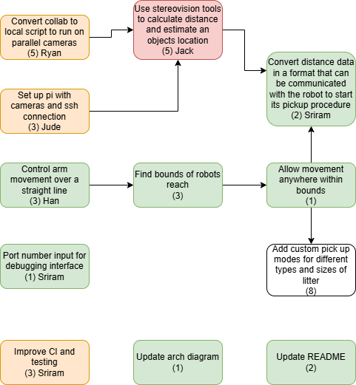
Progress

